Slide 1

Confidence, uncertainty, risk &
decision-making
PRESENTATION TITLE
Presented by:
Name Surname
Directorate
Date
Denis Hugues
IWR, Rhodes University
24 March 2014

Slide 2
Decision Space
Costs
Need environmental (hydrology, water quality, ecology, etc.), socio-economic and engineering design studies to define the decision space and where various possible options fit within the space.
Risks
Benefits
Very bad option from all perspectives
Very good option, but probably not achievable

Slide 3
Confidence
Can be a simple expression:
  I am confident that my result is correct, or
  Here is the result, but I am not very confident for the following reasons …..
  Does not help to inform or reduce the feasible decision space.
Or it can be a statistical evaluation based on probability statements:
  The result is x with 90% confidence bounds of ±y.
  This can inform the decision space by asking further questions – what are the benefits and risks of x+y or x-y?

Slide 4
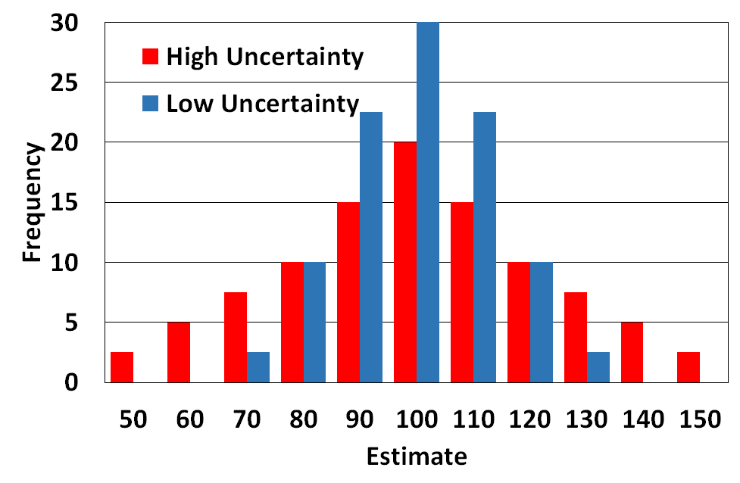
Confidence & Uncertainty
Diagram shows example results of full uncertainty analysis:
Blue: “We are 75% confident that the real value lies between 90 and 120”
Red: “We are 50% confident that the real value lies between 90 and 120”
In the absence of the full uncertainty analysis it is only possible to consider all the sources of uncertainty and qualitatively indicate their possible impact on the estimation.
50% confidence only means that there is a 50% chance that you could be wrong, it does not say by how much, nor in which direction (i.e. higher or lower).
Simple confidence statements therefor do little to populate the decision space.

Slide 5
Confidence & Uncertainty
High confidence implies low uncertainty or little risk that the estimate is wrong.
Low confidence implies high uncertainty and high risk that the estimate is wrong:
  Expressions of low uncertainty should therefore be accompanied by additional risk information that should be designed to populate the decision space.
Where does the precautionary principle fit in IWRM:
  Being precautionary in one area, might impact on another area of the decision space.
  While this might be the right thing to do, the decision should be informed by at least some information.

Slide 6
Engineering design
Here is a design that might cost R10 million, but I am not really sure.
?
Here is a design that will cost between R8 and R15 million, depending on:
Rand/$ exchange rate.
Fuel price.
Inflation and project start date.
Now have a basis for examining costs versus benefits & risk when combined with outputs from other studies.
The same principles should be applicable to the other studies required for decision-making that would ultimately help to fill the decision-making space.

Slide 7
Hydrological design: uncertainty analysis
Assumed that all environmental model outputs are uncertain!
So what is a solution that can be of value to decision-making?
  Define the likely behavioural space (using local or regional information, experience, etc.).
  Generate ensemble simulations that fall into that space.
  Identify the probability structure of that space (i.e. some ensembles might be outliers and therefore considered possible, but unlikely).

Slide 8
Hydrological design: uncertainty analysis
Run all the ensembles through other models and examine the consequences:
  Water resources yield models.
  Socio-economic impact models.
  Environmental flow models.
  etc.

Slide 9
Current approaches
Stochastic analyses in the Yield and Planning models have been routine for many years:
  This is a form of uncertainty analysis but only really accounts for aleatory (natural time series variations) uncertainty.
  There is also a need to account for epistemic (lack of knowledge) uncertainties.
Several groups have discussed this in the recent past:
  But we are not yet at the stage of implementing formal uncertainty analyses as part of routine water resources assessments.

Slide 10
Current approaches & issues
Uncertainty (through lack of confidence statements) is recognized and DWS have dealt with this in the past:
  But in a rather subjective manner.
More formal approaches would enable decisions to be made in a more informed way:
  Need to be based on quantifying uncertainty bounds.
  Need to based on the use of uncertainty bounds within the decision-making process.

Slide 11
Current approaches & issues
The critical issue is that the uncertainty, or simple expressions of confidence, need to relate to the FULL decision space.
  In the context of the Reserve and the classification system this means not only the ecological impacts, but also other impacts of meeting the Reserve.
Example:
  “If the flow & quality criteria are met there is high confidence that the estuary will maintain or improve condition.”
  But what if they are not met by a small amount (to meet other WR criteria), what will be the consequences?

Slide 12
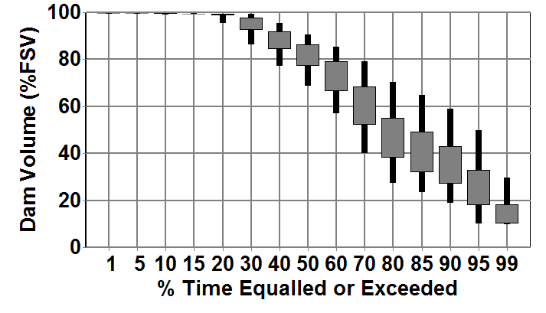
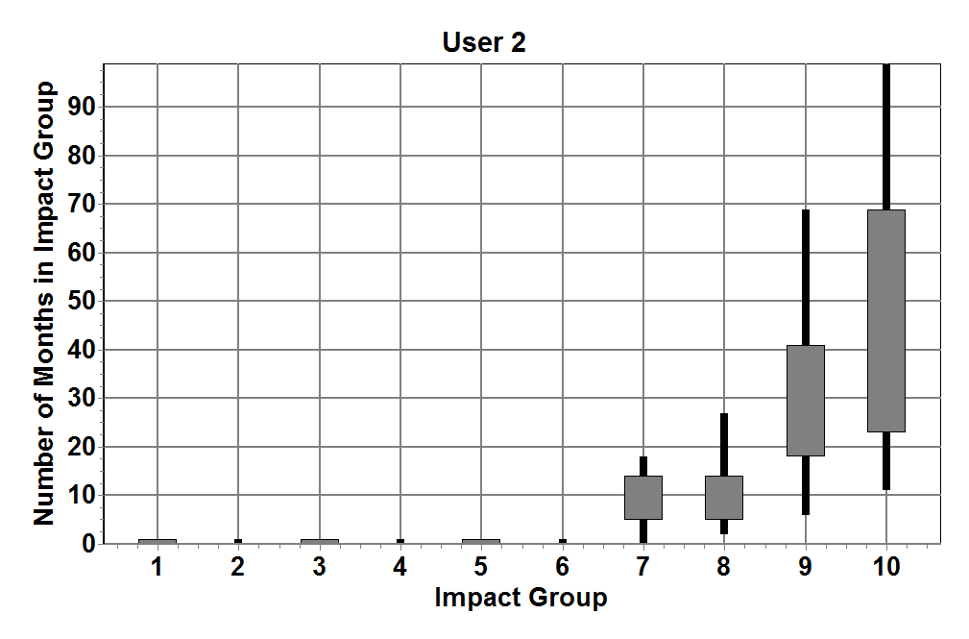
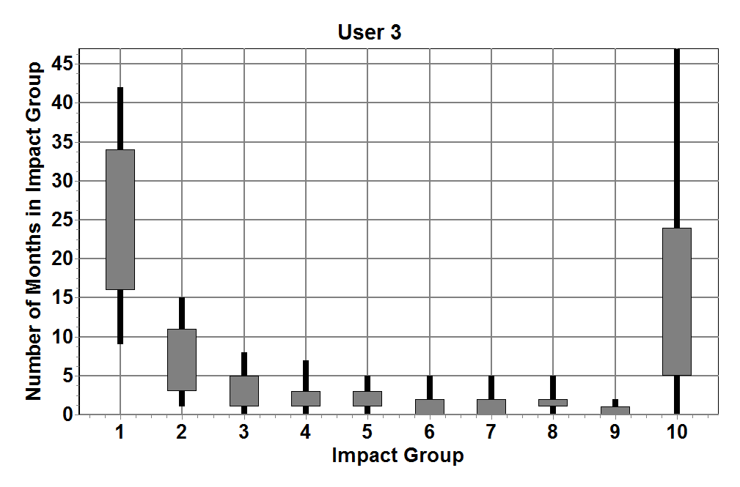
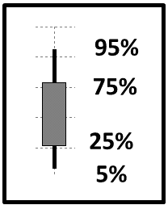
Water allocations: uncertainty analysis
Box & Whisker plot analysis of reservoir storage frequency in an allocation model that uses 500 hydrology ensemble inputs.
Box & Whisker plot analysis of the number of months falling into 10
impact deficit groups (0=no impact, 10=serious impacts) for two users. The B&W percentiles are based on the spread of impacts within the 500 hydrological ensembles.

Slide 13
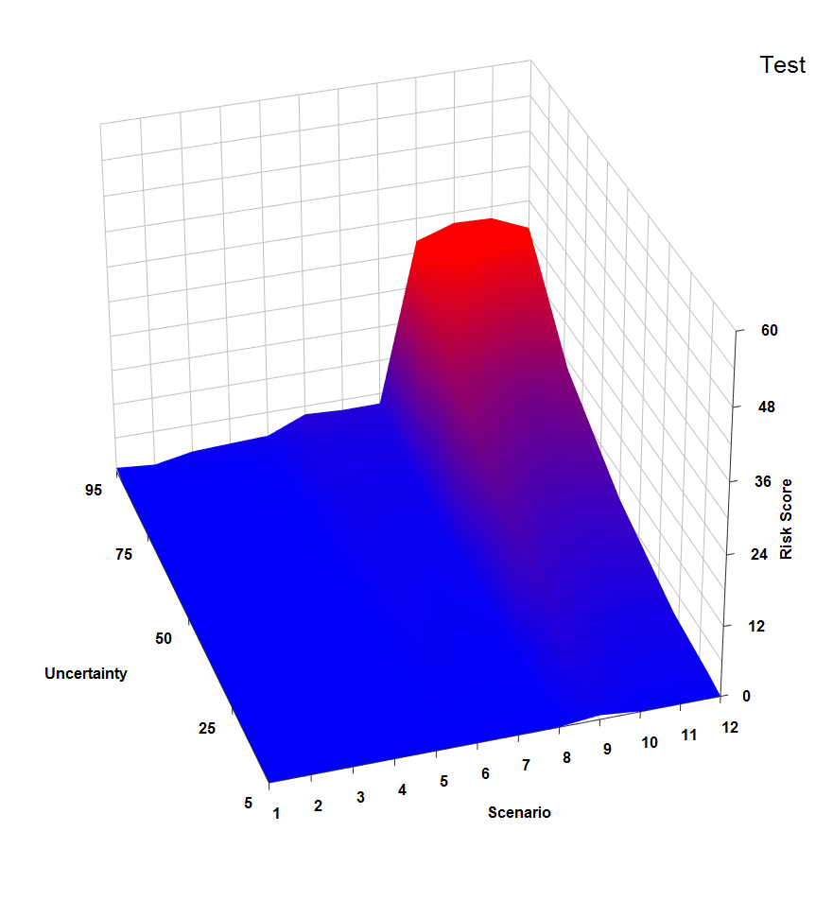
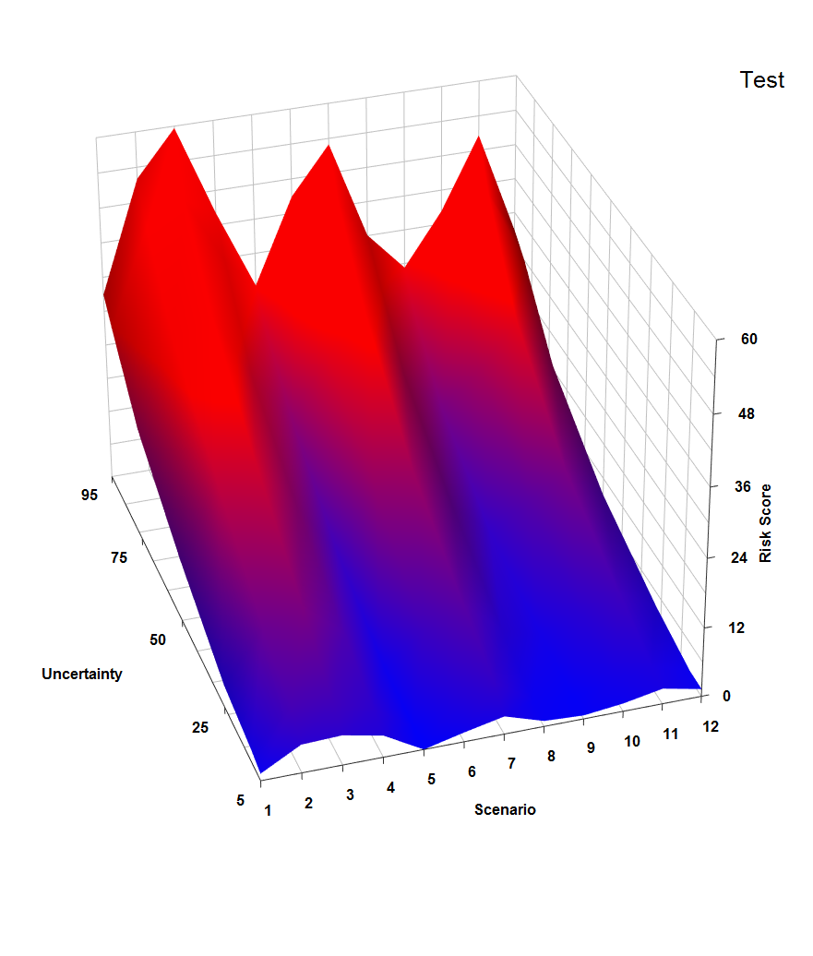
Water allocations: uncertainty analysis
Reserve
Domestic
Water use
Even if the Reserve is treated as a competing user (scenarios 9 to 12), it makes very little difference to the risk profile of the users. It does however, increase the risk profile of the Reserve a great deal.
Trial plots for representing uncertainty and risk from the allocation model, assuming a reservoir used to supply the Reserve and three types of user.
Uncertainty assumed from hydrology (lack of knowledge of impact of afforestation).
12 allocation scenarios (B Reserve * 3, D Reserve * 3, Reserve as User * 3).
Risk measured by frequency of different levels of impact within different hydro-ensembles

Slide 14
Limitations
Not all environmental assessment methods that use outputs from hydrology models are set up to allow for uncertainty analysis (unfortunately):
  To achieve this might be too time consuming when the methods are based on expert opinion.
  Not enough specialists are trained in the use of uncertainty approaches.
Are there alternatives that might help to inform the decision space?
Conventional decision-making processes find it difficult to use uncertain results & information.

Slide 15
Qualified confidence statements
Even if an overall study result is lacking in confidence, it should still be possible to make some confident statements that will inform the decision space.
  Rheophilic fish present and therefore minimum low flows must be greater than x m³ s⁻¹.
  At a low flow of less than x m³ s⁻¹ the concentration of salts or nutrients will exceed acceptable levels.
The critical issue is that the individual studies should be orientated towards filling the decision making space.

Slide 16
Additional perspectives
Environmental studies should be designed on the basis of available data and anticipated uncertainties:
  Why spend large amounts of money on detailed studies when the results will be low confidence because of critical information gaps.
  Better to do desktop studies with limited calibration.
  Multiple desktop studies with uncertain inputs can be used to quantify the uncertainties & will likely be less costly.
  It is assumed, however, that the decision-making process can use the uncertainties constructively.

Slide 17
Additional perspectives
The ‘calibration’ of the methods used in each individual study should be informed by, and aligned to, the best available science.
The interrogation and interpretation of the results must be aligned to the decision-making process, which extends beyond the specialist disciplines of the individual studies.
  The implication is that the decision-making context of the process should come first.
  The decision-making process must be trans-disciplinary.

Slide 18
Definition of decision-making space
Evaluation of available information & identification of critical gaps
Can gaps be filled in the project time frame?
How will these gaps contribute to overall decision-making uncertainty?
Risk too high
Design of individual discipline studies & links to total project
Assessment of results & decision-making risk implications
Make decisions & quantify risks

Slide 19
Conclusions
Future environmental (broadest sense) studies should be framed by D-M space and expected information gaps.
D-M needs to account for uncertainties:
  They are inevitable and can’t be totally removed.
In the absence of formal methods of uncertainty analysis:
  Confidence statements need to be qualified and as detailed as possible.
  Confidence statements need to populate decision space as far as possible.

Slide 20
Conclusions
Explicit inclusion of uncertainty takes everyone out of their comfort zones:
  It is also not very simple to achieve in practice.
  It is also not easy to use in existing decision-making frameworks.
Lack of confidence in one specialist field (e.g. hydrology) can be resolved by:
  Several repeat runs at extremes of expectation.
  Examine consequences (as in scenario analyses of future management conditions that is already done).
  This is essentially sensitivity analysis and should also be informed by the D-M consequences.

Slide 21
Finally
Ultimately, it is all about:
  how much you know,
  how much you don’t know now, and
  how much you might be able to know by spending Rx million versus the costs of other aspects of the project.
If there is little room for adaptive management:
  Spend more money on getting a high confidence result with low uncertainty.
  Otherwise make decisions with uncertainty, monitor to reduce uncertainty and adapt later.

